Slide 1
Basic Text Processing
Regular Expressions

Slide 2
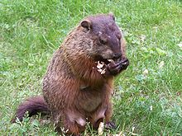
Regular expressions
A formal language for specifying text strings
How can we search for any of these?
woodchuck
woodchucks
Woodchuck
Woodchucks

Slide 3
Regular Expressions: Disjunctions
Letters inside square brackets []
Ranges [A-Z]
Pattern | Matches
[wW]oodchuck | Woodchuck, woodchuck
[1234567890] | Any digit
Pattern | Matches
[A-Z] | An upper case letter | Drenched Blossoms
[a-z] | A lower case letter | my beans were impatient
[0-9] | A single digit | Chapter 1: Down the Rabbit Hole

Slide 4
Regular Expressions: Negation in Disjunction
Negations [^Ss]
Caret means negation only when first in []
Pattern | Matches
[^A-Z] | Not an upper case letter | Oyfn pripetchik
[^Ss] | Neither ‘S’ nor ‘s’ | I have no exquisite reason”
[^e^] | Neither e nor ^ | Look here
a^b | The pattern a caret b | Look up a^b now

Slide 5
Regular Expressions: More Disjunction
Woodchucks is another name for groundhog!
The pipe | for disjunction
Pattern | Matches
groundhog|woodchuck
yours|mine | yours mine
a|b|c | = [abc]
[gG]roundhog|[Ww]oodchuck

Slide 6
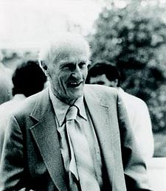
Regular Expressions: ? * + .
Pattern | Matches
colou?r | Optional previous char | color colour
oo*h! | 0 or more of previous char | oh! ooh! oooh! ooooh!
o+h! | 1 or more of previous char | oh! ooh! oooh! ooooh!
baa+ |  | baa baaa baaaa baaaaa
beg.n |  | begin begun begun beg3n
Stephen C Kleene
Kleene *, Kleene +

Slide 7
Regular Expressions: Anchors ^ $
Pattern | Matches
^[A-Z] | Palo Alto
^[^A-Za-z] | 1 “Hello”
\.$ | The end.
.$ | The end? The end!

Slide 8
Example
Find me all instances of the word “the” in a text.
the
Misses capitalized examples
[tT]he
Incorrectly returns other or theology
[^a-zA-Z][tT]he[^a-zA-Z]

Slide 9
Errors
The process we just went through was based on fixing two kinds of errors
Matching strings that we should not have matched (there, then, other)
False positives (Type I)
Not matching things that we should have matched (The)
False negatives (Type II)

Slide 10
Errors cont.
In NLP we are always dealing with these kinds of errors.
Reducing the error rate for an application often involves two antagonistic efforts:
Increasing accuracy or precision (minimizing false positives)
Increasing coverage or recall (minimizing false negatives).

Slide 11
Summary
Regular expressions play a surprisingly large role
Sophisticated sequences of regular expressions are often the first model for any text processing text
For many hard tasks, we use machine learning classifiers
But regular expressions are used as features in the classifiers
Can be very useful in capturing generalizations

Slide 12
Basic Text Processing
Regular Expressions

